Slide 1
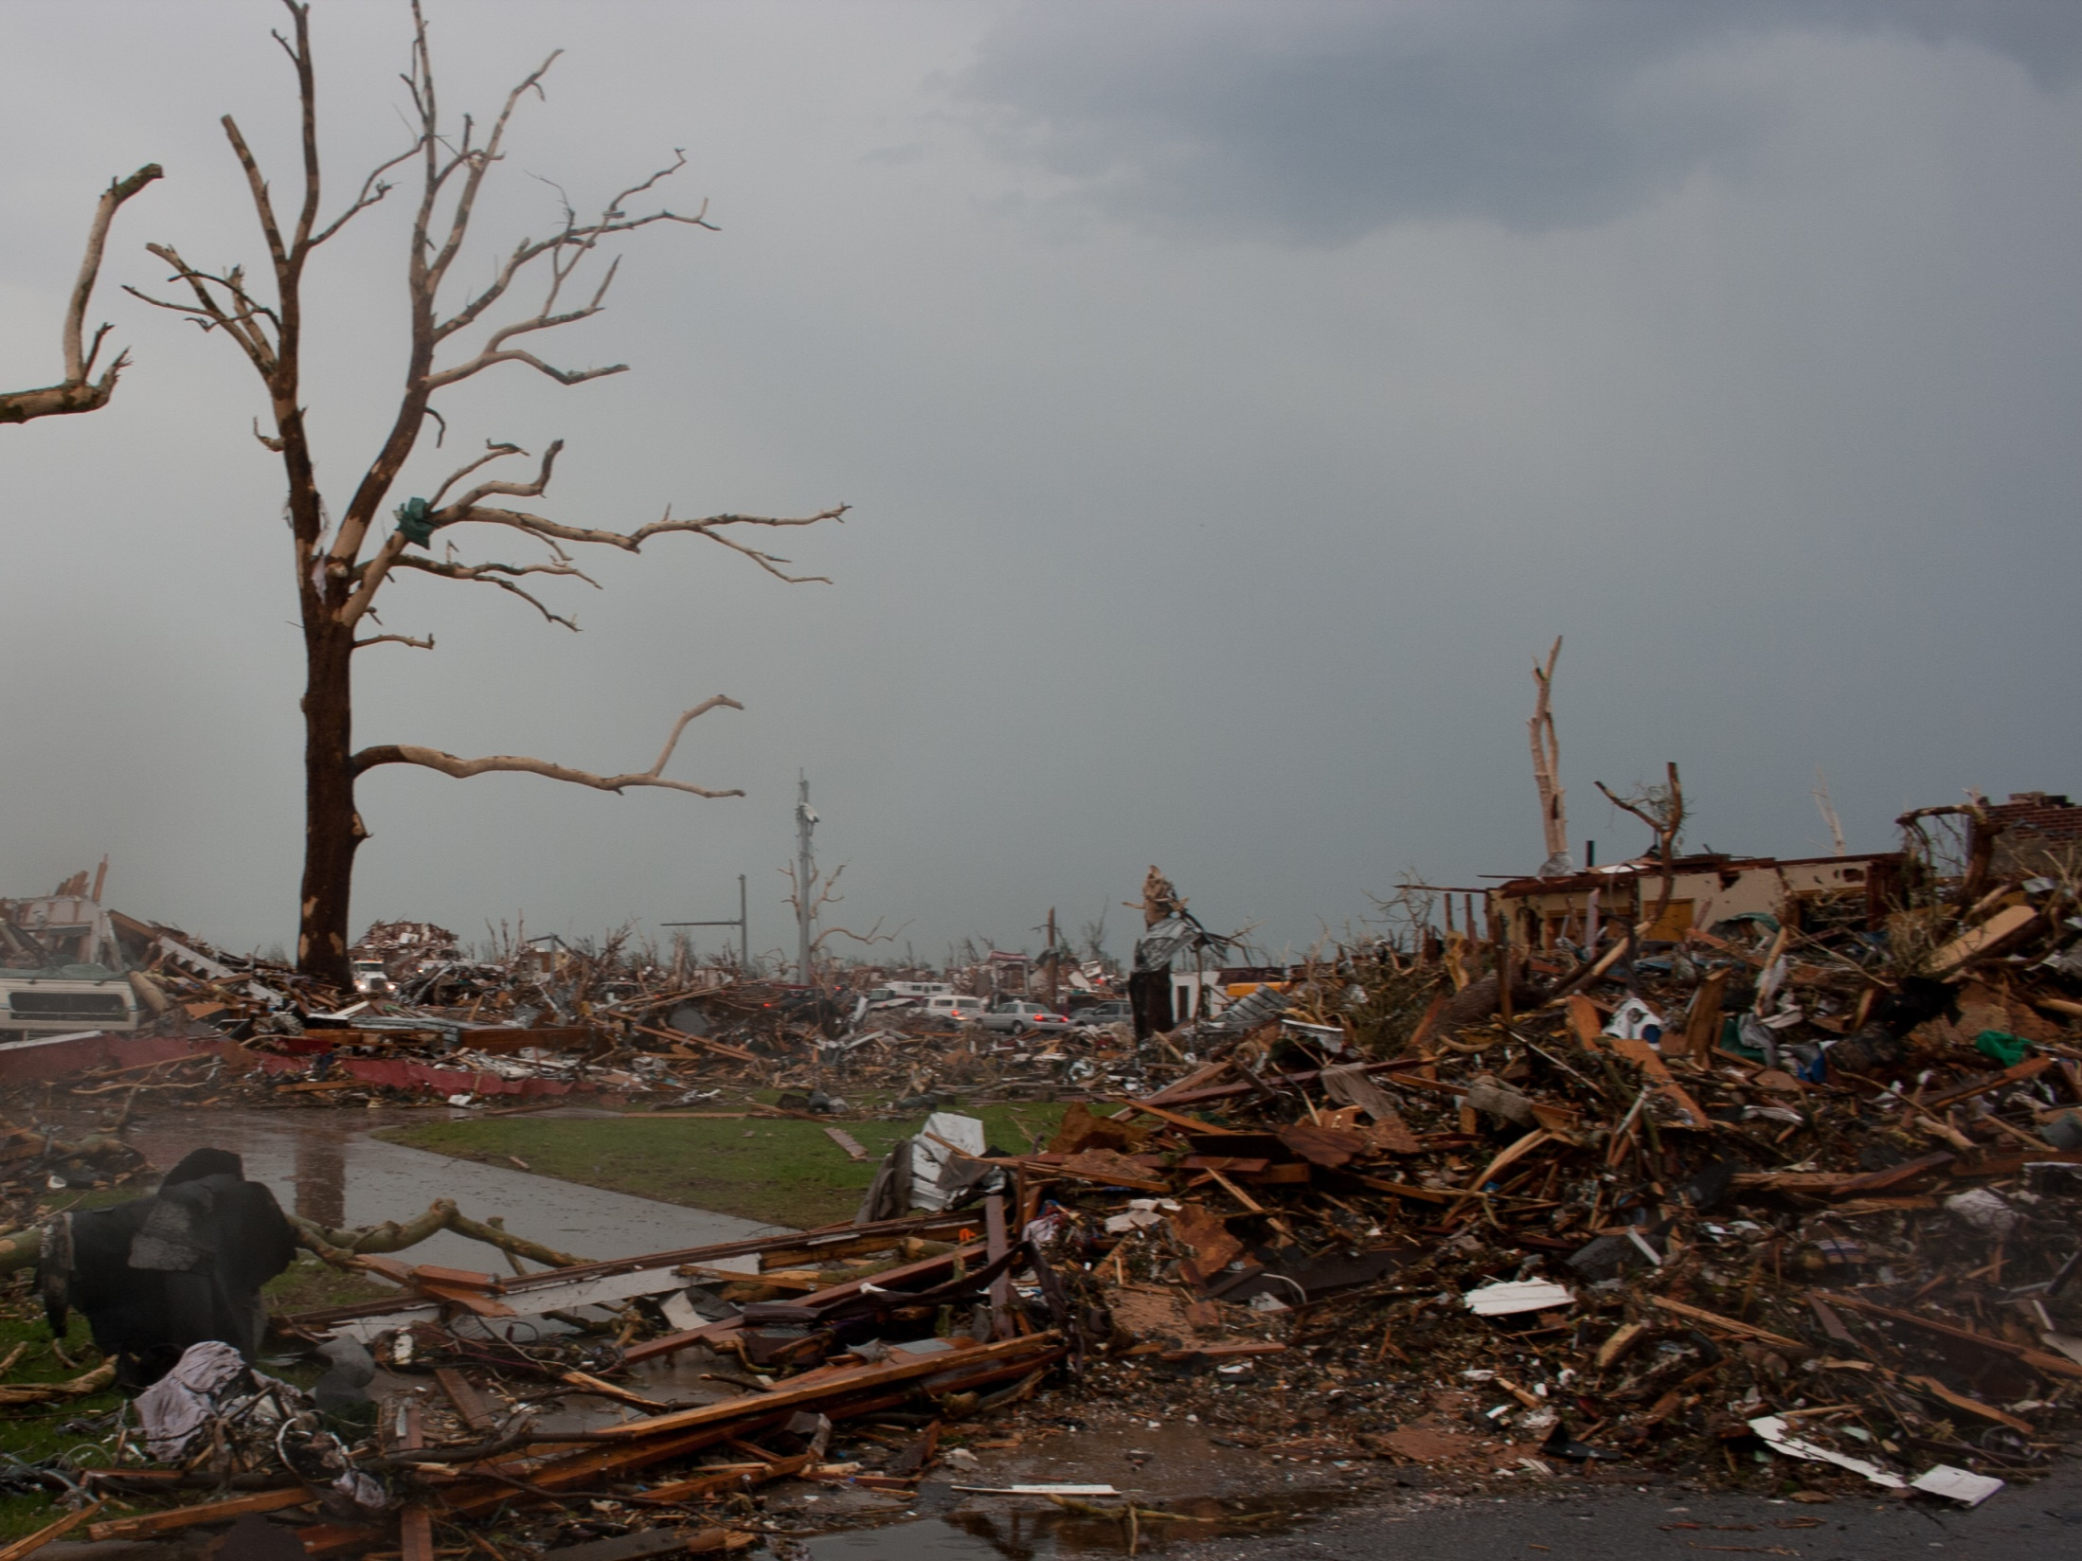
Disaster Recovery Training Campus Preparedness
Notes:
Thank you for choosing to participate in the ICAP disaster recovery training on campus preparedness. This training does count toward your ICAP required trainings.

Slide 2
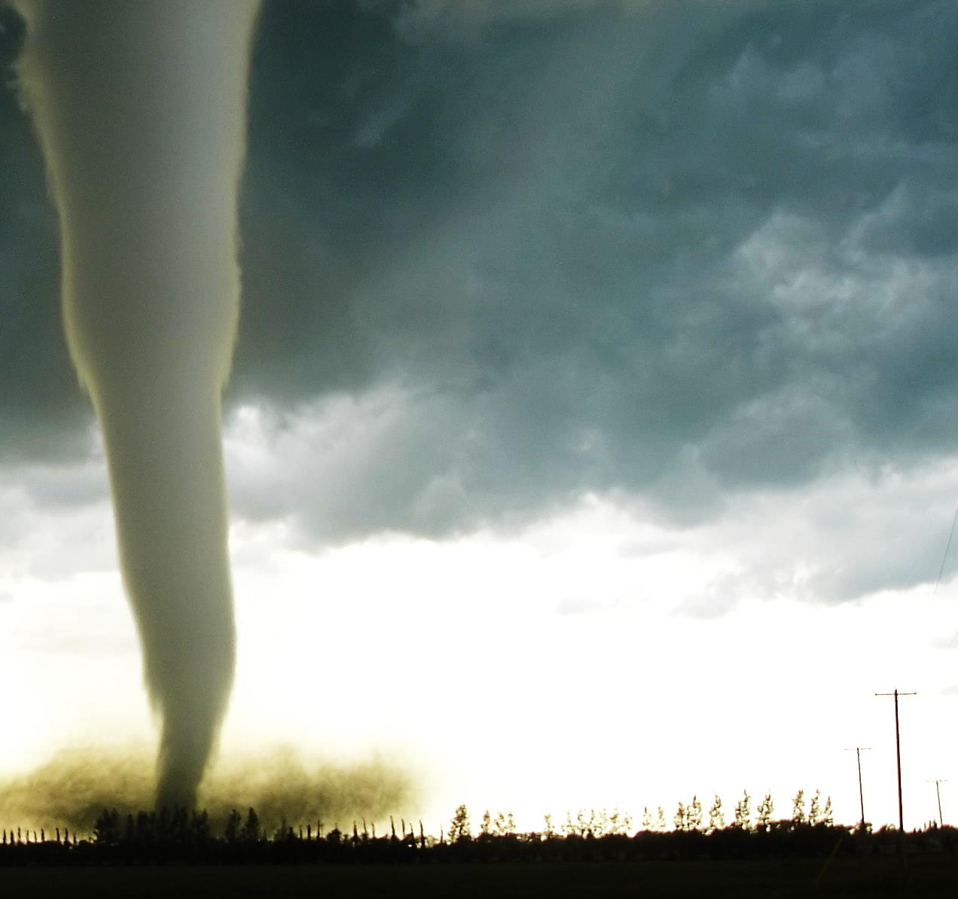
Training Purpose
Inform you of steps you can take as an AmeriCorps member to prepare your campus community in order to recover from a disaster.
We will do this in the following ways:
Define what is disaster recovery
Define what is campus preparedness
Provide a summary of resources to when considering ways to create a plan to address your campus’s ability to recovery from potential disasters.
Notes:
The purpose of this training is to inform you of general steps your College or University can take toward being prepared for a potential disaster. We hope that while you are going through this process you consider your campus’s preparedness as being linked with your community’s preparedness.
To help achieve this goal we will provide a brief definition of disaster recover and campus preparedness followed by a discussion of potential resources to help guide your campus in becoming prepared for a disaster.

Slide 3
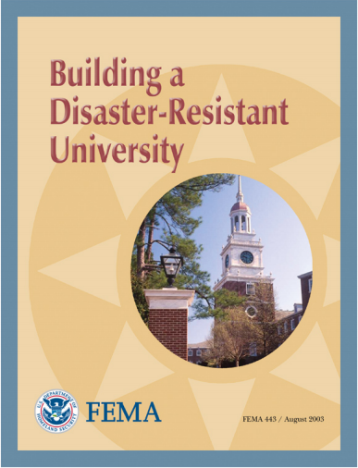
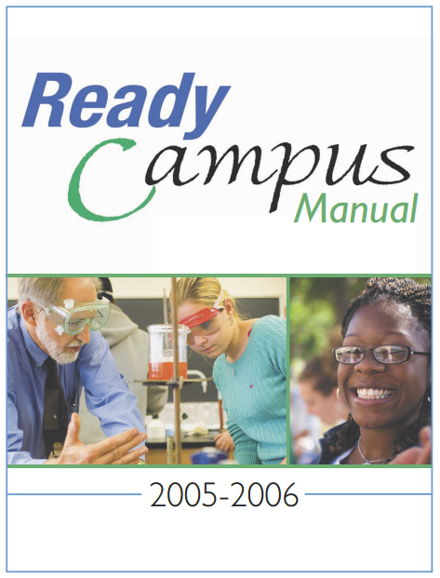
Connecticut | Campus Compact
Notes:
The three resources we will use are the Ready Campus Manual which was created by the Pennsylvania Campus Compact. This is a great resource which highlights how a campus can take steps toward being prepared while also integrating its disaster recovery with the local community.
The second resource is a blog post from the Connecticut Campus Compact. This short post delivers ten suggestions for success in disaster preparedness. We will cover all ten and discuss how they build on the Ready Campus Manual.
The last resource is provided by FEMA and is a manual on how a University can prepare itself for potential disasters.

Slide 4
Definitions
Campus disaster preparedness is the ability of a college or university to directly or indirectly address the needs of a campus when faced with a disaster event.
Disaster Recovery is the establishment of policies and procedures for a given group of people to follow in order to ensure a response to a disaster is timely, effective, and strategic in meeting needs of an affected community.
Notes:
To help us understand what exactly we are talking about here are some definitions that will guide us as we talk about how your college campus can prepare for pending disasters.
Campus disaster preparedness is the ability of a college or university to directly or indirectly address the needs of a campus when faced with a disaster event. Preparedness might include incorporating the community into the campus’s disaster plan.
Disaster recovery is the establishment of policies and procedures for a given group of people to follow in order to ensure a response to a disaster is timely, effective, and strategic in meeting needs of an affected community.
Through the two definitions we hope that you will be able to see how a campus and a community can come together in order to plan how they can recover from a disaster in a timely, effective, and strategic manner.

Slide 5
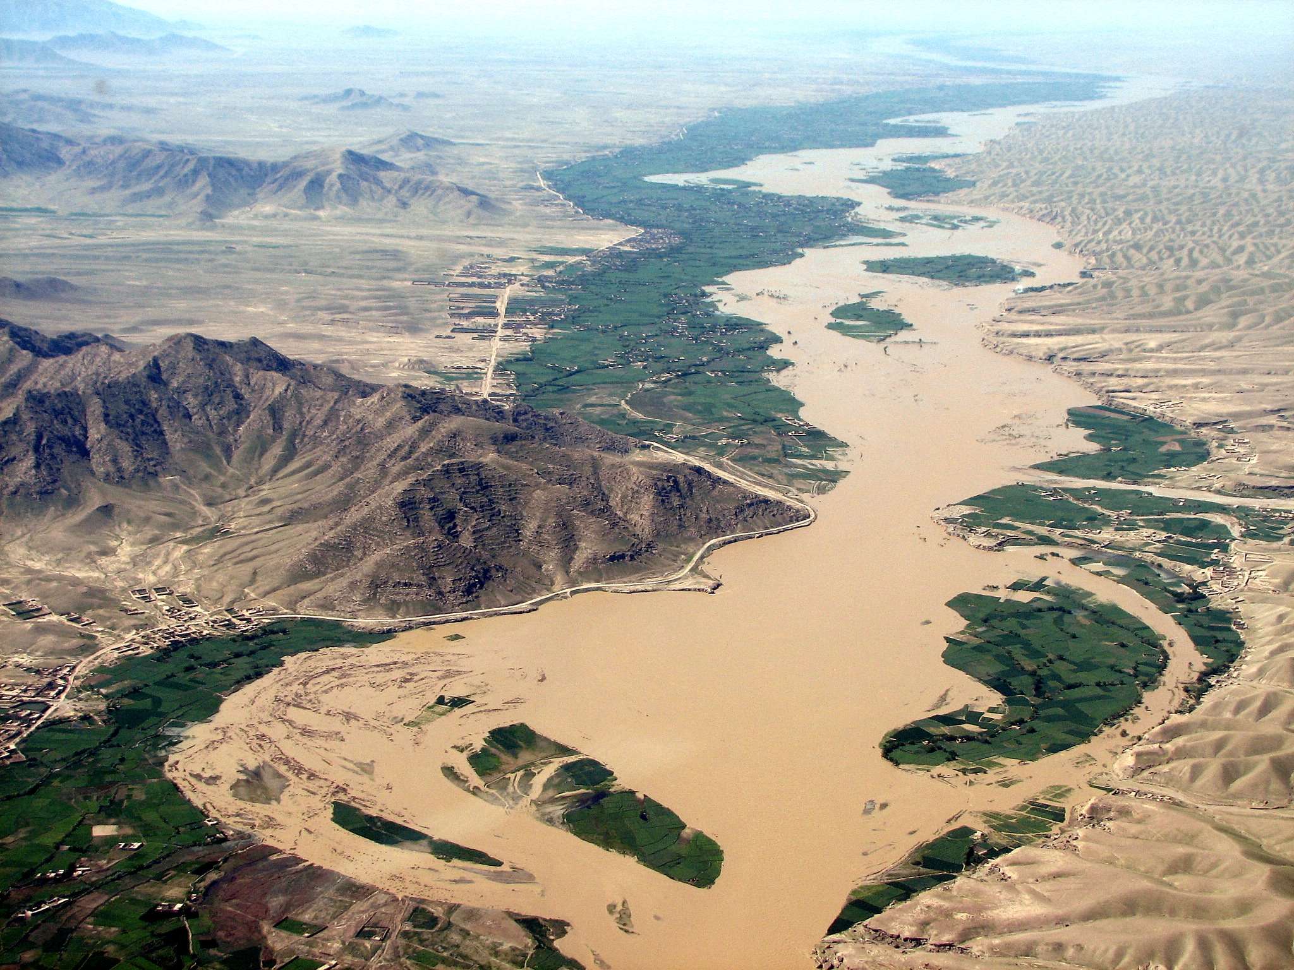
Notes:
The Ready Campus Manual (RCM) was created by the Pennsylvania Campus Compact as a resource and system to create effective disaster response partnerships between campuses and communities across the state of Pennsylvania. The RCM provides direction for an institution to follow when choosing to collaborate with community organizations around emergency management. Case studies are highlighted throughout the RCM, serving as examples of best-practices and potential resources. The value of this manual is in its ability to connect emergency management directly with curriculum based learning outcomes. By providing examples and direction for service learning courses which address emergency management, the RCM not only asks higher education administration to develop disaster plans, but it places leadership and accountability on students as well.

Slide 6
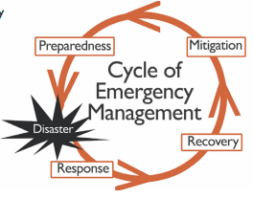
The Cycle of Emergency Management
Step One: Mitigation
Staying ahead of the disaster
Step Two: Preparedness
Creating a plan
DISASTER
Step Three: Response
Communicate and Mobilize
Step Four: Recovery
Repair, rebuild, recover
Notes:
It might be helpful for you to understand the cycle of emergency management. The RCM provides a quick description of what this cycle looks like. Step one is mitigation, or staying ahead of the disaster. This includes considering where new buildings are being created. It might not make sense to build a new auditorium on a flood plane which typically floods every three to five years unless there is an appropriate levy system.
Step two is preparedness. This is where your campus and community plan and test how they will address a disaster if one occurs. At some point a disaster will happen and all of the mitigation and preparedness will come into play. That’s when step three happens: communicate and mobilize. Time to take your plan and put it into action. Step four is recovery from the disaster. Recovery may include physical recovery such as replacing buildings, but also psychological recovery for the citizens of that location who experienced the loss of their community, family, and friends.

Slide 7
Phase One: Organizing campus participation
“In phase one of the Ready Campus initiative, the college or university assembles a Campus Advisory Group and selects a Ready Campus Coordinator to gather support for and develop the initiative within the institution.”
What does this mean?
Create a Campus Advisory Group
Have regular meetings
Develop a mission statement
Create partnerships with community officials
Establish a hub for emergency management
Designate one individual to be responsible for emergency management
Plan how to use resources effectively
Structural Facilities
Volunteers
Equipment
Notes:
The RCM guides campuses through a set of three phases. The first is organizing the campus participation. “In phase one of the Ready Campus initiative, the college or university assembles a Campus Advisory Group and selects a Ready Campus Coordinator to gather support for and develop the initiative within the institution.” This quote from the manual describes the process in which a campus must recognize and prioritize its ability to meet the needs of a disaster recovery. The manual suggests that a campus create an advisor group which meets regularly and guides the process of mitigation and preparation. The campus should then choose a hub, or central office to hold the responsibility when a disaster occurs. Finally, the campus will need to plan on how to use resources effectively. This includes identifying potential equipment, organizing volunteers ahead of time, and thinking creatively about what equipment can be used to prepare for disasters.

Slide 8
Phase Two: Forming Community Partnerships
“The officials from the city and university recognize that, as neighbors, they share risks and can more effectively mitigate the risks together.”
What does this mean?
Identify potential community partners
Form a committee which includes the community
Organize meetings
Notes:
The second phase assumes that your college has developed a plan to prepare for disasters. At this point it is time to take the plan to the community and find ways to mold your plan to meet the needs of the community. The RCM guides you through identifying potential community partners and then collaborating with them to ensure that their businesses or nonprofits are able to quickly recover. This process includes continual communication and discussion about how a college or university can best meet the needs of the community.

Slide 9
Phase Three: Putting ideas into action and maintaining long-term partnerships
“Exercising the emergency plans will test the success of training programs and the partners’ readiness to respond to emergencies.”
What does this mean?
Formalize the relationship with an MOU
Perform trainings and exercises
Identify long-term goals
Publicize Success
Notes:
The last phase is devoted to developing long-term relationships. The RCM suggests “exercising the emergency plans will test the success of training programs and the partners’ readiness to respond to emergencies.” This is where the collaboration learns from its own mistakes and gaps. If there is information and additional training that needs to occur a test of the current state will demonstrate that need to the campus and community.
At this point it is important for the partnership to become formalized through the use of an MOU. This process will create a long-term relationship between the campus and the community as it formalizes the agreement. By publicizing the partnership the relationship is recognized by the greater community and is seen as a potential future resource.

Slide 10
Building Ready Campus Partnerships
Phase One: Organizing campus participation
Phase Two: Forming the partnership with the community
Phase Three: Putting ideas into action and maintaining long-term partnerships
Notes:
In closing, the Ready Campus Manual provides a broad understand of how any college or university can partner with its community to create a sustainable and successful disaster recovery collaboration.

Slide 11
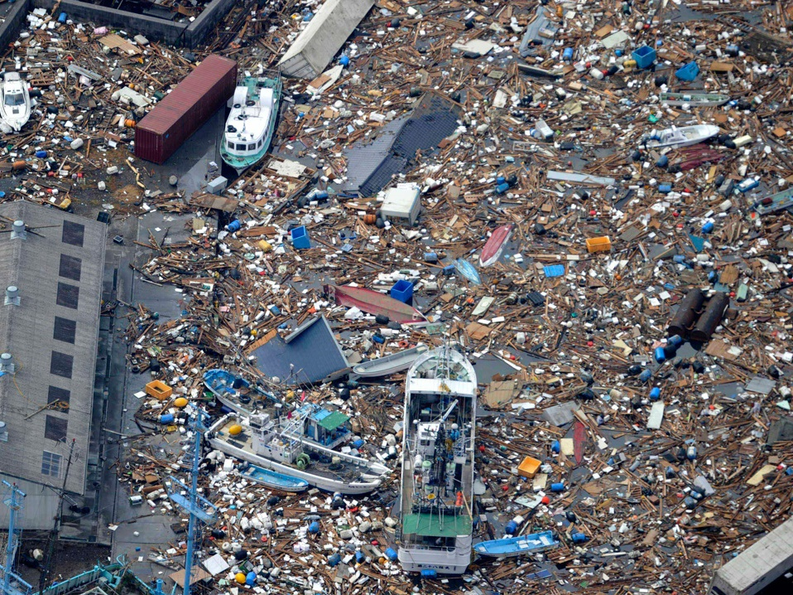
Connecticut | Campus Compact
Notes:
The Connecticut Campus Compact put together a blogpost on this topic from 11/01/12. This training will only briefly discuss the tips provided, but you can view the original blog post for more information. A link is provided at the end of this training.
http://blog.fairfield.edu/campuscompact/resources/disaster-response

Slide 12
Get Buy-in and Support from your President
Don’t go it alone! Get support from your campus leadership. They will be able to leverage resources in your partnership’s benefit.
Centralize your Response Operations
Focus the leadership of operations on one core group or individual.
Work through Key Community Partners
Partner with organizations which will be able to provide strategic benefit to a disaster relief.
Notes:
The first tip is to get support from the Campus President. Leadership from the top on this topic will help set the tone across campus and prove to the community that your campus is a serious partner in this collaboration. The second tip is to centralize the operations; this advice echoes the Ready Campus Manual as does work through key community partners. The advice here is that when considering community partners try to keep in mind who will be able to provide the most support to the community and campus. Not all community partners are the same, try and take advantage of their assets and use those to your advantage during a disaster.

Slide 13
Harness, Celebrate, and Oversee Student Energy
Students can be organized and directed as effective volunteers.
Prepare Students (and other Volunteers)
Train your volunteers so they know what to expect during a disaster and what is to be expected of them.
Be Flexible
Disasters are unpredictable and you should be able to work in an ever changing situation. Develop contingency plans to help you make decisions quickly.
Notes:
The fourth tip is vital and as ICAP members you can probably relate. When something bad happens to your campus or community you want to help! It’s natural because that place is your home. It is up to your campus to find ways to harness your ability to recover or prepare for a disaster.
The sixth tip is one that can describe any collaboration: be flexible. In a disaster situation you do not know what is going to happen and you will need to respond to those challenges in real time. In short, develop a robust contingency plan.

Slide 14
Be in it for the Long Haul
Disasters never disappear as quickly as they come. Reassure your community partners that you are going to be supportive of their efforts, as they are of yours.
Consider coordinating with other campuses
Other campuses may have additional resources which they can lend to the recovery.
Be patient
Your community may not be able to recover as swiftly as your campus and your campuses role may not be clear right away. Be patient until you are able to see what the greatest benefit your resources can offer.
Be Safe
Always ensure the safety of yourself and your campus before you begin serving others.
Notes:
The Connecticut Campus Compact advises that your campus understand that disaster recovery never disappears quickly and a long term relationship will be needed in order to see a successful recovery. In this way, your campus should be patient with the disaster recovery process. Small steps will lead to big rewards and those steps might not happen as quickly as expected.
Finally, be safe. Disasters can lead to dangerous situations and your safety is of the utmost importance. Ensure the safety of your campus community before you begin serving others.

Slide 15
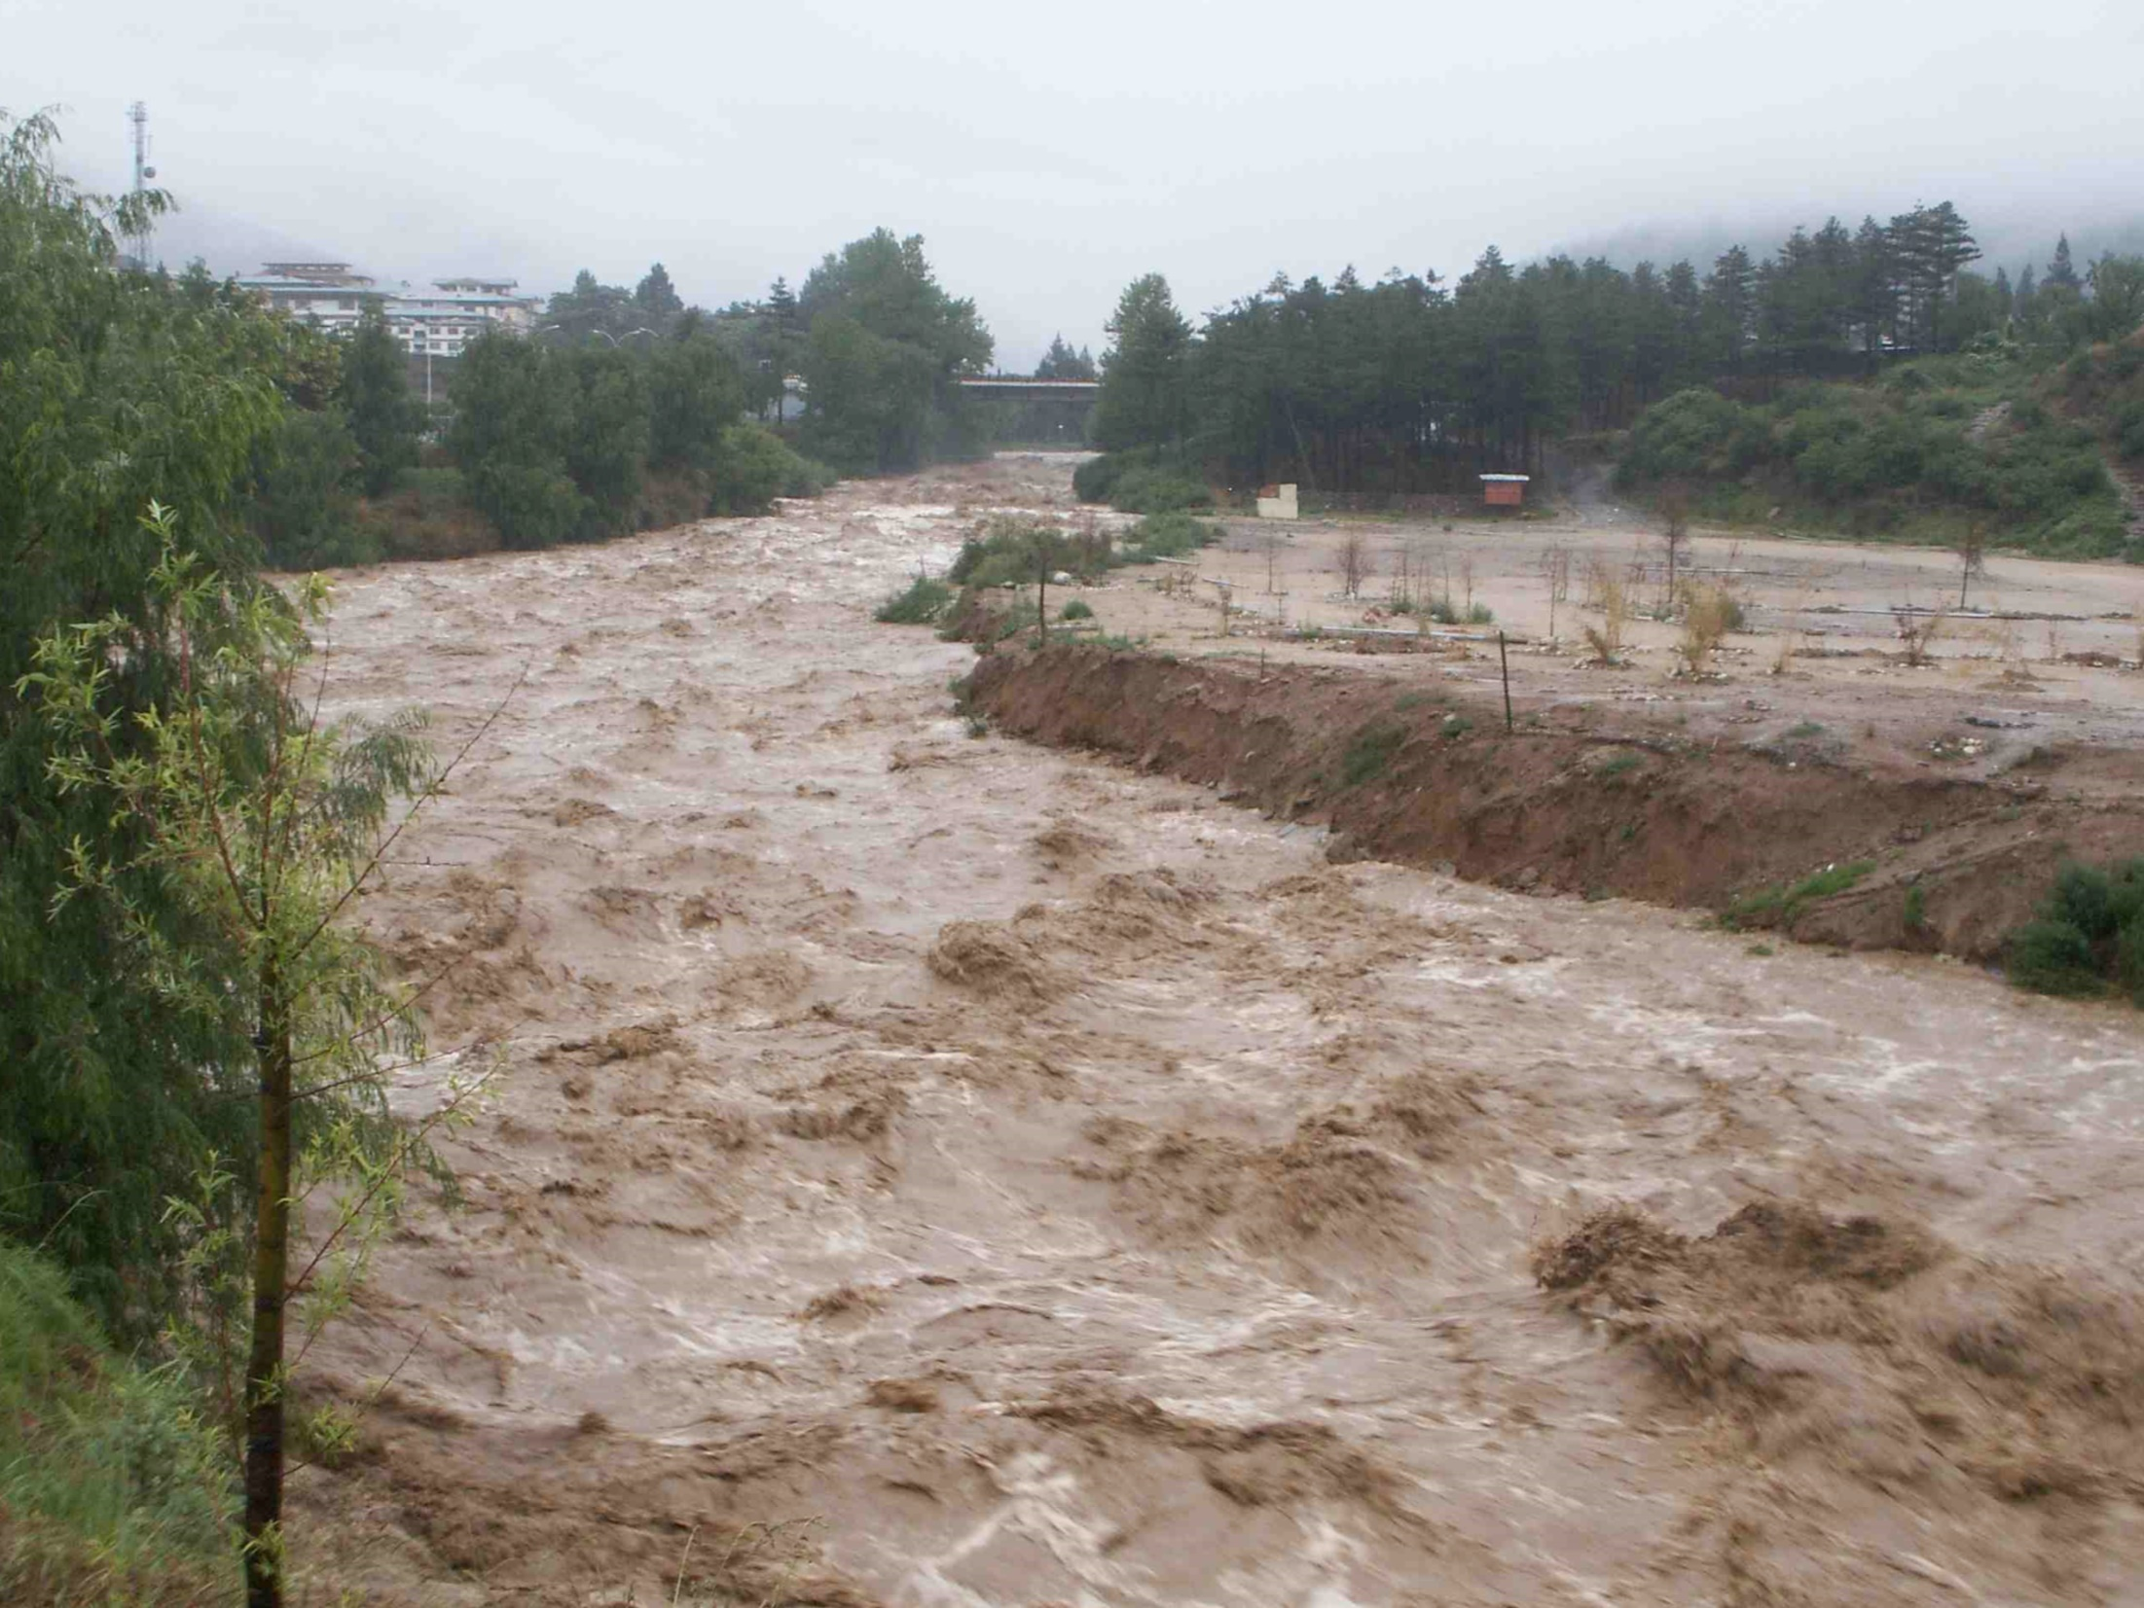
Notes:
FEMA has developed a process for University’s to use when preparing for disasters.

Slide 16
Notes:
Their process is not as focused on building a campus-community partnership, but has an incredible amount of materials. This tool would serve a campus best in first preparing itself and then finding ways to approach the community. Because of its limited scope on campus-community partnerships this training will only briefly discuss its contents.

Slide 17
Hazard Mitigation
Phase 1: Organize Resources
Begin planning how to access resources in case of an emergency
Create an inventory of available resources
Phase 2: Hazard Identification and Risk Assessment
Identify potential hazards
Assess potential vulnerabilities
Phase 3:Developing the Mitigation Plan
Plan how to address potential disasters
Update this document regularly
Phase 4: Adoption and Implementation
Practice your plan and adjust it as needed
Notes:
The FEMA disaster-resistant university manual moves a campus through a four phase process. In brief, they are to organize resources, identify hazards and risks, develop a mitigation plan, and then formally adopt and implement the disaster plan. This process is similar to the Ready Campus Manual, as it suggests to organizing a committee to direct disaster planning. However, the committee does not include community members and focuses more on preparing the campus for pending disasters.

Slide 18
Ready Campus Manual
Connecticut Campus Compact
Building a Disaster Resistant University
Notes:
Thank you for completing the Campus Preparedness disaster training. Please feel free to click on the above links to access the information described in this training.
Please remember to fill out your member training certification form. If you do not have one, please visit the ICAP website to download your copy.
http://iowacollegeamericorps.weebly.com/online-training.html

