Slide 1
Disaster Response, Relief, & Recovery
Notes:
Thank you for choosing to participate in the ICAP disaster recovery training on Disaster Response, Relief and Recovery. This training does count toward your ICAP required trainings.
In today’s training, we will be discussing what to do after a disaster occurs. What happens after a disaster is just as important the preparation. This training will also address the emotional recovery individuals and communities go through. Living through a disaster and its recovery is a shock to every part of a community; the physical buildings, potential loss of life and livelihood, and because of these experiences individuals experience emotional shocks. By the end of this training you will knowledgeable of the process of disaster response.

Slide 2
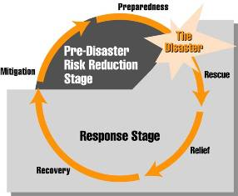
Disaster Timeline
Pre-disaster
Disaster
Post-disaster
Notes:
Before we begin the training we will cover the disaster timeline. When working in disaster relief, it is important to remember the disaster timeline:
The pre-disaster phase is when a community begins preparing itself for potential disasters. Steps are taken to mitigate damage from disasters such as building a levy system or moving businesses out of floodplains. Preparedness refers to action steps taken by a community to ensure that resources are allocated in timely and strategic ways to address the recovery.
The second phase is when the disaster occurs. This is when immediate reactions and steps are taken. This might include evacuating an area or seeking appropriate shelter.
The final phase is the post-disaster response phase. As you can see from the visual the response phase is the longest part of the disaster timeline. And because of this, it requires the most energy.

Slide 3
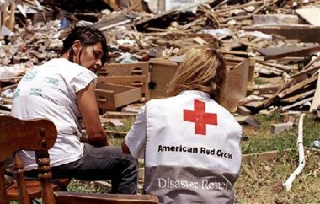
Rescue
Address what had physically occurred.
Respond to most pressing needs
Injuries
Clean-up
Deaths
Notes:
In the post-disaster phase there are three stages of response that occur; rescue, relief, and recovery. First, you must respond to a disaster and address the physical damages of the event. This may include helping injured individuals, cleaning up large debris, and, sadly, moving the remains of those who passed away. The first stage demonstrates by far the most visible affects of a disaster such as the physical damages to the environment and people.
Responding to a disaster requires that a community addresses the most pressing needs in a timely manner. Injuries come first. For some disaster victims the response to their injuries could mean life or death. The second most pressing response is cleaning up the area to prevent further accidents and to allow for you to properly assist those affected by the disaster. Lastly, you must take care of any deaths that occurred during the disaster or afterwards because of the disaster.
Your response to these pressing needs will help you begin to address the physical damages caused by the disaster.

Slide 4
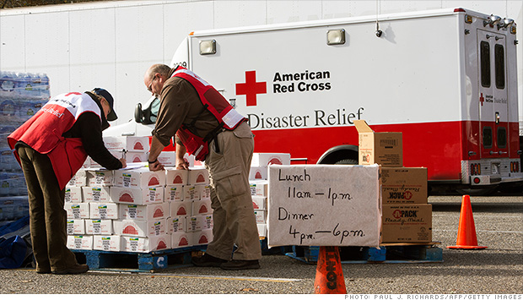
Relief
Address immediate needs of community
Food assistance
Housing assistance
Rebuilding assistance
Notes:
The next stage of responding to a disaster is providing relief. Once you have responded to the pressing needs, you need to assess what assistance is needed. The most important forms of disaster relief are food and housing assistance so that those affected by the disaster can eat normally and be placed in safe place until the rebuilding process begins.
Rebuilding assistance will come after all of the most pressing physical needs are met. Rebuilding may take weeks, months, or years depending on the scale of the disaster.

Slide 5
Recovery
Long term response to disaster
Physical needs usually addressed first
Human physical recovery
Community physical recovery
Most often, they mental recovery needs after a disaster are overlooked and forgotten.
Notes:
The last stage of post-disaster response is recovery; this is the long-term response to a disaster and is oftentimes overlooked by eager volunteers and news crews. While addressing the physical needs of individuals and the community come first, it is equally important to remember that there are also mental scars and barriers to overcome when dealing with a disaster.

Slide 6
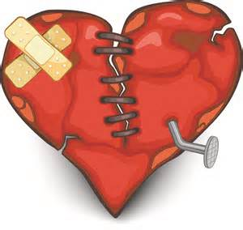
Emotional Recovery
Coping with stressful events takes time and depends on the person
Relationships with friends, family, and others may be affected
Pay attention to your needs as well as those around you
Notes:
We must remember that coping with stressful events takes time and depends on the individual. If someone has lived through a flood or a tornado, there house may be rebuilt, but the physiological scars of living through the storm and the shock of losing their home, their memories, their childhood, their family ties, could be so much deeper than the physical damage. If a family member or friend was lost or injured during the event, that may also add stress to the person. After a disaster it is important to remain aware of your own needs as well as those around you.

Slide 7
Steps to a Full Recovery
Take care of your physical safety first
Limit your exposure to the sights and sounds of the disaster
Eat healthy
Rest
Notes:
Getting ourselves and our lives back in a routine that is comfortable for us takes time. In order to fully recover after a disaster you should take the following steps:
-Take care of your safety. Find a safe place to stay and make sure your physical health needs and those of your family are addressed. Seek medical attention if necessary.
-Limit your exposure to the sights and sounds of disaster, especially on television, the radio and in the newspapers.
-Eat healthy. During times of stress, it is important that you maintain a balanced diet and drink plenty of water.
-Get some rest. With so much to do, it may be difficult to have enough time to rest or get adequate sleep. Giving your body and mind a break can boost your ability to cope with the stress you may be experiencing.

Slide 8
Steps to a Full Recovery
Stay connected with family and friends
Be patient with yourself and those around you
Set priorities
Gather information about assistance and resources
Stay positive
Notes:
-Stay connected with family and friends. Giving and getting support is one of the most important things you can do. Try to do something as a family that you have all enjoyed in the past.
-Be patient with yourself and with those around you. Recognize that everyone is stressed and may need some time to put their feelings and thoughts in order. That includes you!
-Set priorities. Tackle tasks in small steps.
-Gather information about assistance and resources that will help you and your family members meet your disaster-related needs.
-Stay positive. Remind yourself of how you’ve successfully gotten through difficult times in the past. Reach out when you need support, and help others when they need it.

Slide 9
Resources
Red Cross: Recovering Emotionally
http://www.redcross.org/find-help/disaster-recovery/recovering-emotionally
To reach out for free 24/7 counseling or support, contact the Red Cross Disaster Distress Helpline at 1-800-985-5990 or text “TalkWithUs’ to 66746.
Notes:
For more information on Disaster Response and emotional recovery, visit the Red Cross website.
Please remember to fill out your member training certification form. If you do not have one, please visit the ICAP website to download your copy.
http://iowacollegeamericorps.weebly.com/online-training.html

