Slide 2
AGENDA
The purpose of this information session:
Provide general information on ICAP
Describe requirements
Answer any questions or concerns

Slide 3
INTRODUCTIONS
Name
Year in school
Major area
Have you served with AmeriCorps before?
Why is service important to you?

Slide 4
Iowa Campus Compact
National organization consisting of 35 state offices
President’s association including public, private, four-year and two-year
Coalition of more than 1,100 presidents
Build strong communities, educate next generation of responsible citizens
Notes:
Campus Compact is a national coalition of more than 1,100 college and university presidents—representing some 6 million students—who are committed to fulfilling the civic purposes of higher education. As the only national higher education association dedicated solely to campus-based civic engagement, Campus Compact promotes public and community service that develops students’ citizenship skills, helps campuses forge effective community partnerships, and provides resources and training for faculty seeking to integrate civic and community-based learning into the curriculum.
Campus Compact’s membership includes public, private, two- and four-year institutions across the spectrum of higher education. These institutions put into practice the ideal of civic engagement by sharing knowledge and resources with their communities, creating local development initiatives, and supporting service and service-learning efforts in areas such as K-12 education, health care, the environment, hunger/homelessness, literacy, and senior services.
History
Campus Compact was founded in 1985 by the presidents of Brown, Georgetown and Stanford Universities and the president of the Education Commission of the States. In the mid-1980s, the media portrayed college students as materialistic and self-absorbed, more interested in making money than in helping their neighbors. The founding presidents believed this public image was false; they noted many students on their campuses who were involved in community service and believed many others would follow suit with the proper encouragement and supportive structures.
Campus Compact was created to help colleges and universities create such support structures. These include offices and staff to coordinate community engagement efforts, training to help faculty members integrate community work into their teaching and research, scholarships and other student incentives, and the institutional will to make civic and community engagement a priority. Today more than 98% of Campus Compact member campuses have one or more community partnerships, and more than 90% include service or civic engagement in their mission statements. These campuses are putting their knowledge and resources to work to help build strong communities and educate the next generation of responsible citizens.

Slide 5
Iowa Campus Compact
Mission:
Campus Compact advances the public purpose of college and universities by deepening their ability to improve community life and to educate students for civic and social responsibility.

Slide 6
Iowa Campus Compact
Vision:
Campus Compact envisions colleges and universities as vital agents and architects of a diverse democracy, committed to educating students for responsible citizenship in ways that both deepen their education and improve the quality of community life. We challenge higher education to make civic and community engagement an institutional priority.

Slide 7
Iowa College AmeriCorps Program
170 college students serving 300 or 450 hours of service in their campus community
Upon satisfactory completion eligible for $1,132 or $1,415 education award
Project goals include:
Increase capacity and meet needs of local nonprofits
Increasing students’ sense of civic responsibility and connections in local Iowa community
Increase rate of college student volunteerism in Iowa

Slide 8
Iowa College AmeriCorps Program
In 1993, the Corporation for National and Community Service (CNCS) was established. The Corporation was created to connect Americans of all ages and backgrounds with opportunities to give back to their communities and their nation.
Mission: to improve lives, strengthen communities, and foster civic engagement through service and volunteering.
Oversee management of AmeriCorps, SeniorCorps, and Learn and Serve America
Notes:
Iowa Campus Compact uses national service as a strategy to meet our mission.

Slide 9
Benefits
$1,132 education award
The difference you make in the community
Provides opportunities to grow professionally and personally
Allows networking with other students committed to improving communities
Joining the National Service movement through AmeriCorps

Slide 10
Qualifications
Be a United States citizen, a United States national, or a legal permanent resident of the United States
Be at least 17 years of age.
Have a high school diploma, GED or agrees to obtain one while under service to the Program.
Must be a current student in good standing with one of IACC’s member institutions of higher education.
You will need a government issued ID (e.g., passport or drivers license) in order to sign up for the Iowa College AmeriCorps Program.

Slide 11
Commitment
Serve at an area not-for-profit
Recruit 10 volunteers
Attend all required meetings and trainings
Submit monthly time sheet
Serve 300 hours (6 hrs per week) in 12 month period to the date of enrollment
Ideally complete program before end of second semester or must live in area during extended breaks (summer)

Slide 12
Service Plan
Your service must build, or improve the capacity of an organization to fulfill it’s mission.
You can serve at any qualifying non-profit organization, including public schools, government agencies, charitable non-profits, faith-based centers, and arts and culture institutions.
You can serve part of your hours on campus.
You can also spend some of your service on member development/training.

Slide 13
Service Plan
Service should be completed at organizations that are part of your service plan
Intentional and pre-determined
Do not expect service hours to be approved if they are not pre-determined as part of the service plan
Can also do one-time volunteer projects
Can re-visit service plan
Must serve in every month while in-service (could be training hours)

Slide 14
Fundraising
Fundraising can account for up to 10% of your total service term and includes:
Members are allowed to fundraise for specific service projects and solicit in-kind donations
The maximum number of member development hours you can accrue with each term of service is:
30 hours out of the 300

Slide 15
Fundraising: the fine print
AmeriCorps members may raise resources directly in support of your program’s service activities. Examples of fundraising activities AmeriCorps members may perform include, but are not limited to, the following:
Seeking donations of books from companies and individuals for a program in which volunteers teach children to read;
Writing a grant proposal to a foundation to secure resources to support the training of volunteers;
Securing supplies and equipment from the community to enable volunteers to help build houses for low-income individuals;
Securing financial resources from the community to assist in launching or expanding a program that provides social services to the members of the community and is delivered, in whole or in part, through the members of a community-based organization;
Seeking donations from alumni of the program for specific service projects being performed by current members.

Slide 16
Prohibited Activates
While charging time to the AmeriCorps Program, accumulating service or training hours, or otherwise performing activities supported by the program or the Corporation for National and Community Service, the member may not engage in the following prohibited activities:
Attempt to influence legislation;
Organize or engage in protests, petitions, boycotts, or strikes;
Assist, promote or deter union organizing;
Impair existing contracts for services or collective bargaining agreements;
Participate in, or endorse, events or activities which are likely to include advocacy for or against political parties, political platforms, political candidates, proposed legislation, or elected officials;

Slide 17
Prohibited Activates cont’d
Engage in religious instruction, conduct worship services, provide instruction as part of a Program that includes mandatory religious instruction or worship, construct or operate facilities devoted to religious instruction or worship, maintain facilities primarily or inherently devoted to religious instruction or worship; or engage in any form of religious proselytization;
Provide a direct benefit to a for-profit entity, labor union, partisan political organization, an organization engaged in the religious activities described in the preceding subclause;
Any other activities as the Corporation determines will be prohibited, upon notice to Iowa Campus Compact;
Engage in partisan political activities or other activities designed to influence the outcome of an election to any public office.
Provide support to a non-profit entity that fails to comply with restrictions related to 501(c)(3) status

Slide 18
Prohibited Activates cont’d
Assist in voter registration drives;
Raise funds for his/her living allowance or for an organization’s general operating expenses or endowment;
Write grant applications for CNCS grants, including AmeriCorps grants;
Write grant applications for funding provided by other federal agencies;
Provide abortion referrals or services.
Recruiting volunteers to perform prohibited activities or distributing materials related to prohibited activities (i.e. Activities in support of the Prohibited Activities are not allowed. For example, it is not allowable for an AmeriCorps member to recruit community volunteers to perform a prohibited activity, such as voter registration drives, nor is it allowable for an AmeriCorps member to distribute materials related to a prohibited activity, such as registration information for religious instruction.)

Slide 19
Suspension/Termination
Members who leave the program without completing their service receive no education award and may become ineligible to participate in an AmeriCorps program again
Exception is if have personal compelling circumstance – must inform program immediately if there is a reason as to why you cannot complete the program. The CNCS determines whether it is personally compelling.
Not having enough time or not liking it is not considered personally compelling
Members can be terminated for failure to comply with program policies and requirements

Slide 20
Education Award
The Education Award
Is a voucher issued by the National Trust in Washington, D.C.
Is received by the member two to four weeks after being exited from the program.
Can be applied to a financial institution or to an institution of higher education (Title IV school).
Is considered taxable income by the IRS in the year it is used, not the year it is earned.
Can be taken away from a member if a member receives a felony drug conviction after successfully completing their service term.
Visit the ICAP website member section for more information on how to receive your Education Award.

Slide 21
Education Award cont’d
Individuals can earn up to two full education awards in a lifetime, which is currently a total of $10,700
The education award is issued to members two to four weeks after successful completion of service hours, evaluation, and exiting.

Slide 22
Education Award cont’d
The Education Award can be used in three ways:
Past → members can repay qualified student loans such as the Stafford, Perkins, Federal Direct/Indirect
Present → members can apply the voucher to their current education expenses through the financial aid office on their campus*
Future → Members can use the voucher for up to seven years toward graduate programs, individual classes, specialty and trade schools, and study-abroad
*Check with the financial aid office to see how the education award may be used for tuition or other educational expenses.

Slide 23
Member Evaluations
At the end of your term you and your supervisor will fill out evaluations on how you feel you performed throughout your service.
You are also asked to complete a pre- and post-civic engagement survey

Slide 24
Timesheets
All time keeping for ICAP program hours is done through the IowaGrants.Gov online system.
If you have not already done so, please register for Iowagrants. Information on how to create an account and how to enter hours is available on the ICAP website.
Timesheets are submitted monthly by the 5th of each month. Supervisors will then evaluate your timesheets and approve them by the tenth of each month.

Slide 25
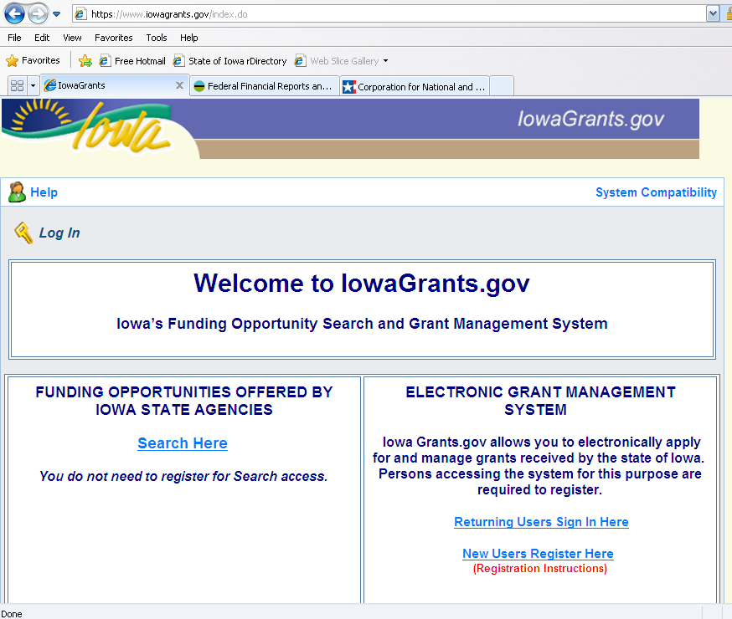
Timesheets
Go to Iowagrants.gov and click on “returning user”

Slide 26
Timesheets
Click on “Create an Account”
Enter your first and last name
Click “Register”

Slide 27
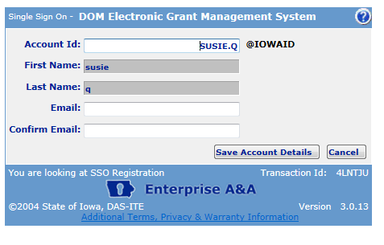
Timesheets
Enter and confirm email address
Click on Save Account Details
Make note: this will be your account id (user id) for IowaGrants.

Slide 28
Timesheets
Click “OK” to continue registering

Slide 29
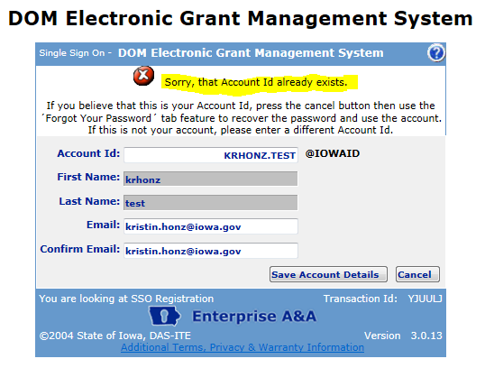
Timesheets
If this account already exits, you will receive this error message
If you have followed the instructions, the ONLY reason you should receive an error message is because someone else (with the same name or using the same name) already has an account in the system. [Note: More than 20,000 people have accounts, so it would not necessarily be that unusual to have a duplicate account.] To work around it, use your nickname, add your middle name or middle initial to the first name or last name field.

Slide 30
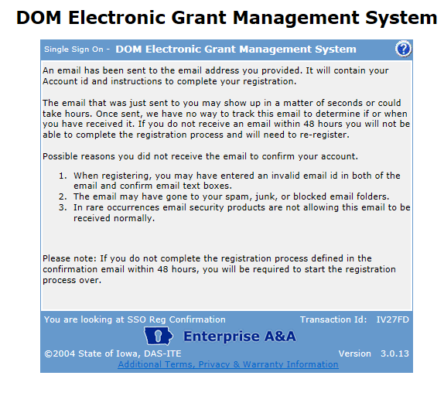
Timesheets
Registration initial confirmation
Please note: you must complete the process within 48 hours. If you do not, you will need to start the process over.

Slide 31
Timesheets
Email Confirmation
You will get an email from the system to complete the account activation. Click on the link and use the registration confirmation token. This email will come from entaa.noreply@iowa.gov (see below). If you receive an error message after clicking on the link, please see the “help section” of this message to determine how to proceed.
You must be on the same computer and using the same browser as when you started the account activation process.
You must complete this process (all four steps) within 72 hours of when you start, otherwise the system will purge your registration.
Your account activation is NOT complete until you re-log into the system and complete the registration process.

Slide 32
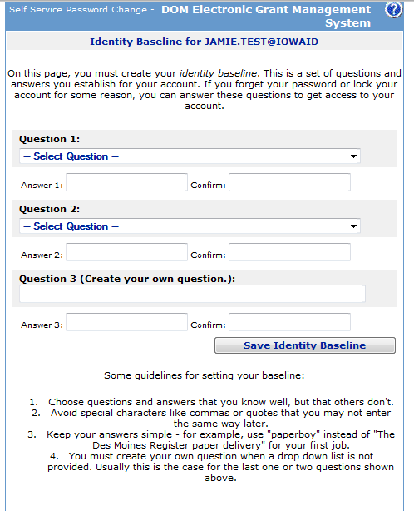
Timesheets
Baseline Questions
After clicking the link in your email you will be directed here.
You will then be forced to enter your identity baseline questions and responses.
Enter your questions and answers.
Click “save identity baseline” to continue.
Note these helpful hints for establishing your baseline

Slide 33
Timesheets
Enter New Password
You will then be forced to change the password.
Enter new password and confirm new password
Click on “Save New Password”
Passwords should contain a minimum of 8 alphanumeric characters (a mix of upper and lower case) including at least one special character.
Note: you may not use pieces off your name or e-mail address in your password.

Slide 34
Timesheets
Re-Registering for IowaGrants
You will now need to log into the system to complete the account activation process. (This is step 4 from the email you received. If you do not do this immediately, it may cause your registration to lapse or be purged from the system.)

Slide 35
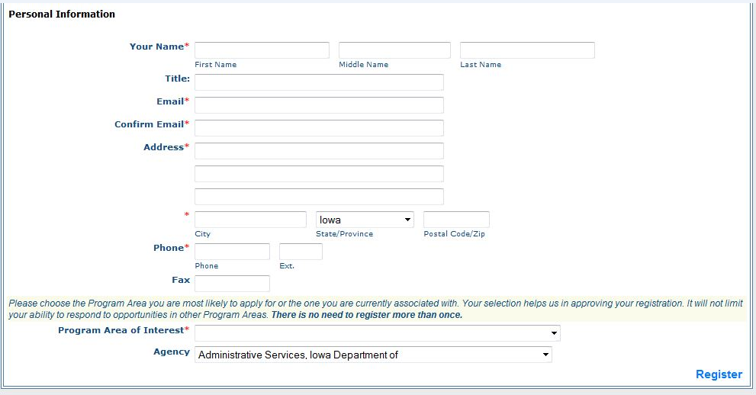
Timesheets
Re-Registering for IowaGrants:
Enter your information. You may use Iowa Campus Compact address and phone number if you wish.
Iowa Campus Compact
Pappajohn Education Center
1200 Grand Ave
Des Moines, Iowa 50309
Phone: 515-235-4681
While the system instructions do not make this clear, it is important that the program area “AMERICORPS” is selected from the drop-down list. This will expedite registration.

Slide 36
Timesheets
IowaGrants confirmation:
You will receive a confirmation pop-up and an email will be generated to you from the system. This indicates your registration has been submitted for approval. Approvals can be expected with 5 business days. If there is a delay, please contact Justin Ellis at jellis@iwcc.edu or 515-235-8641.

Slide 37
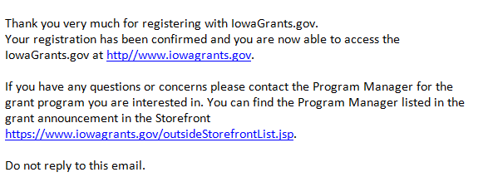
Timesheets
IowaGrants confirmation:
When you account is approved, you will receive an account approval confirmation email message from the system. You account will now need to be linked to your Timesheets. This will happen within 24 hours of receiving this message.

Slide 38
Timesheets
ACCOUNT ACTIVATION ERROR MESSAGES:
INCOMPLETE A&A REGISTRATION: If the member did not complete the registration process, for example, if they created the username and password, but did not use the confirmation email to complete the process, the system will say that they are already in the system. If this happens, they should use the confirmation email they received to complete the process. It is important to note that the individual must be using the SAME computer AND browser they used when they started the registration process to complete it. You must also ensure that your browser has Cookies and JavaScript enabled. NOTE: The individual only has 48 hours from the start of the application process to finish it. They should check their SPAM folders for the confirmation messages.
SORRY THE LINK YOU USED IS NO LONGER VALID: Your account is in limbo. Do the following: a) click on: https://entaa.iowa.gov/entaa/sso?appId=DOM_GMS&callingApp=https://www.iowagrants.gov/login.do&tab=forgotid,
b) enter your email address and then press the “Retrieve A&A ID” button. If you get the message:
Sorry, could not find your account and you are sure you entered your email correctly, then your account did not get activated and you will need to press the “Create An Account” tab and start the activation process over (go to step 11).
We have sent an email reminder to {YourEmail.Address@Domain] then your account was created and you need to go back to your email and check for a new message from this system. Remember, these messages come from entaa.noreply@iowa.gov, so check your spam and filter folders! Remember, you only have 48 hours to complete the process, so you should locate the message and complete the process as soon as possible.

Slide 39
Training
Member development/training is an important part of AmeriCorps service.
Member development hours can account for up to 20% of your total service term and include:
Training related to your direct service
Professional conferences or workshops
Faculty meetings or agency staff meetings
Required ICAP Capacity Building online training
You may either complete the trainings online, or in person. Visit the ICAP website member section for access to the online trainings.

Slide 40
Training
All members must complete the Capacity Building and Volunteer Management training available through the ICAP website.
If your service plan lasts longer than four months you are required to complete the following additional trainings.
Citizenship
Disaster preparedness
Communication
Life after AmeriCorps

Slide 41
Questions or Concerns
Please contact Justin Ellis, ICAP Program Director for any questions you may during your AmeriCorps experience!
Iowa Campus Compact
Justin Ellis – Program Director
Office: (515) 235-4681
Cell: (515) 707-1931
Jellis@iwcc.edu

